Slide 1
FINAL PRESENTATION
G7T3
Ethan Yang, Kwon Soo Yeon, Nanda Gian,
Qi Haodi, Sia Yan Rui

Slide 2
TABLE OF CONTENTS
01
Schedule
02
Bug Metrics
03
Git
04
Main Takeaways

Slide 3
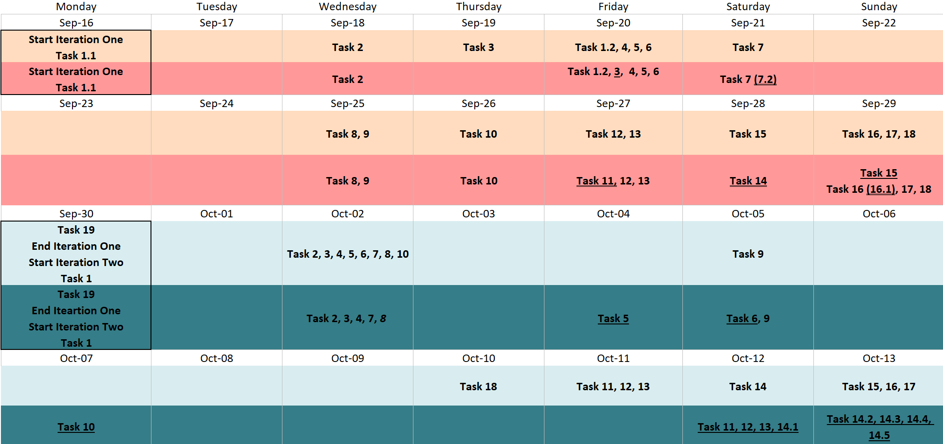
SCHEDULE (ITER 1 - 2)

Slide 4
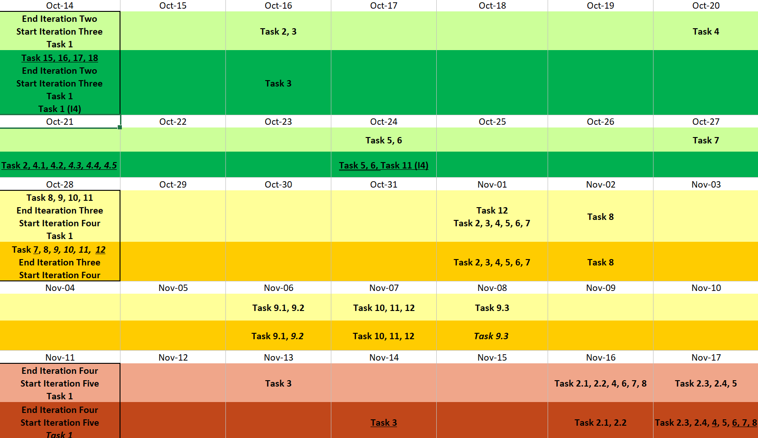
SCHEDULE (ITER 3 - 5)

Slide 5
Problems faced tracking schedule
Sometimes our allocated time for pair programming will clash with other project meetings that we have. Hence we have to rearrange the time or even make compromises.
⇒ Try our best to finish the task is completed before its dependency starts

Slide 6
FUNCTIONALITIES
Do you plan to drop any functionalities?
Do you plan to use any PHP frameworks?
No
No

Slide 7
ADDITIONAL FUNCTIONALITIES
3)What functionalities did we add?
Enrolled course and exam information

Slide 8
BREAKDOWN OF WORK*
*The hours shown above remove the duplicated hours from tasks with subtasks
 | PROGRAMMING |  | NON-PROGRAMMING |  | TOTAL
 | Hours | % | Hours | % | Hours | %
Ethan | 52 | 20.3% | 70.5 | 19.94% | 122.5 | 20.12%
Haodi | 58.5 | 22.76% | 66 | 18.67% | 124.5 | 20.72%
Nanda | 44.83 | 17.44% | 72.5 | 20.51% | 117.33 | 19%
Soo Yeon | 49.42 | 19.23% | 73 | 20.65% | 122.42 | 19.94%
Yanrui | 52.25 | 20.33% | 71.5 | 20.23% | 123.75 | 20.28%
Total | 257 | 100% | 353.5 | 100% | 610.5 | 100%

Slide 9
TASK ALLOCATION (Programming Tasks)
 |  | Ethan | Haodi | Nanda | Soo Yeon | Yan Rui
UI | Home Page
 | Login Function
 | View Bidding Results
Functionality | Drop-bid
 | Drop-section
 | Update-bid
 | Round 1 clearing logic
 | Round 2 clearing logic
 | Bootstrap
Backend

Slide 10
Why our task allocation is fair
Stronger coders will code at earlier phases and guide the weaker ones; the weaker ones will code more later; Weakers ones will handle more admin tasks
Members who did more functionalities were given simpler one, and those who did fewer functionalities were tasked more complex ones.
Balance between quantity and difficulty level so overall work allocation is quite fair.

Slide 11
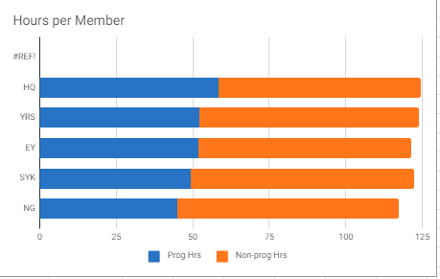
Why our task allocation is fair

Slide 12
BUG METRICS
ITERATION | TOTAL POINTS | MITIGATION
1 | 111 | Stop current development and resolve the bug immediately. Project Manager reschedules the project.
2 | 89
3 | 41
4 | 78
5 | 25
Notes:
a visual representation for the metric that shows the values of the metric overtime
how you used the metric to fix problems identified
examples of concrete follow-on actions you took to fix the most severe prolem identied by the metric
some challenges faced when collecting and using the metric

Slide 13
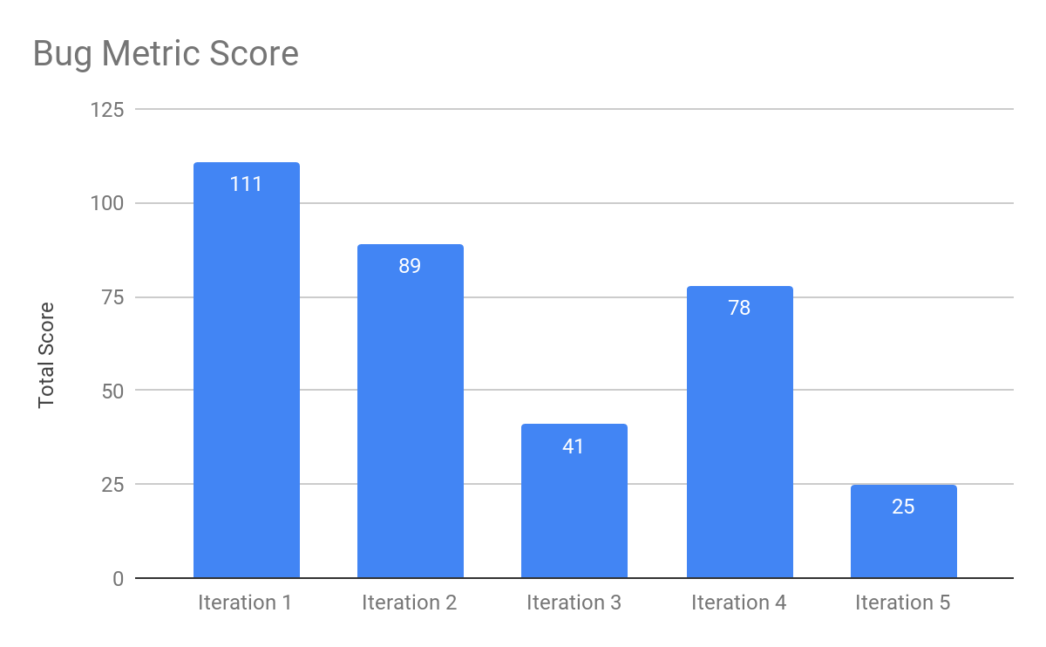
BUG METRICS
Notes:
a visual representation for the metric that shows the values of the metric overtime
how you used the metric to fix problems identified
examples of concrete follow-on actions you took to fix the most severe prolem identied by the metric
some challenges faced when collecting and using the metric

Slide 14
BUG METRICS - Fix Problems
At the start of the PP, the pair will check the bug metrics first if there is any unsolved bugs, and if the bug will affect their functionalities.
→ If so, they will debug that bug first
→ If not, they will move on to complete their own functionalities first; if they finish earlier than planned end time, they will start debugging

Slide 15
BUG METRICS - Follow-on Examples
A bug is discovered using json checker: Students can bid courses with clashing lesson/exam time table with enrolled courses
⇒ Find out why the test case failed by checking the time tables in phpmyadmin
⇒ Test if the function works for bidded courses
⇒ add in the checking for enrolled courses
⇒ manual testing and debugging
⇒ rerun that particular json test case

Slide 16
BUG METRICS - Challenges
When we discovered a bug, we are inclined to directly debug it instead of recording it on the bug metric first → Some bugs may not be recorded in the bug metric
⇒ Commit the debugged codes can remind us
⇒ Check against Git history to get any missing bugs

Slide 17
Git
We plan the PP at different timings possible to avoid conflict
Before we push, we will send out message to the group to inform the rest so that we do not commit and push together to avoid conflict
Members take turn to code and commit so that the commits are more even

Slide 18
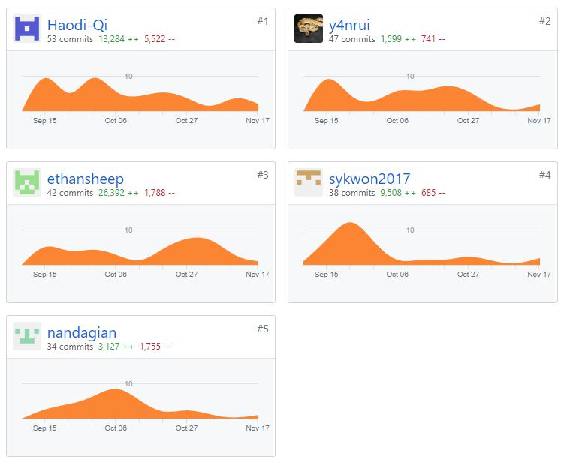
Git

Slide 19





MAIN TAKEAWAYS
I learnt the importance of communication and building rapport with my teammates. It makes resolving conflict a lot easier and helps in the efficiency of the project
Importance of scheduling - regardless of whether you manage to achieve your planned schedule or not
SOO YEON
ETHAN
Using agile and iterative processes to tackle changing requirements is important. Following the schedule was also crucial to completing the project before the deadline.
NANDA
It is important to constantly check against the schedule and remember to fill up the information there
Agile and SCRUM methodologies, the importance of project management in a big project like SPM, the use of JSON.
HAODI
YANRUI
Notes:
mAin takeaways you gained from the project
team conflict / issue and how your team resolved it
something interesting about your team members you did not know before spm

Slide 20
THANK YOU

